Slide 1
Anomaly Detection in Financial Transaction(Online Payments) Using Machine Learning

Slide 2
Table of contents
INTRODUCTION
EXECUTIVE SUMMARY
VISUALIZATIONS/INTERPRETATION
MODEL EVALUATION
CONCLUSION

Slide 3
introduction
Fraud detection is defined as a process that detects scams and preventsfraudsters from obtaining money or property through false means. Fraudis a serious business risk that needs to be identified and mitigated intime. which is a multinational financial services group that offers retailand investment banking, pension management, asset management, and payment services

Slide 4
Dataset description
The features in the dataset 943717 rows x 11 columns
Step: represents a unit of time where 1 step equals 1 hour
type: type of online transaction
Amount: the amount of the transaction
NameOrig; customer starting the transaction
OldbalanceOrg: balance before the transaction
NewbalanceOrg: balance after the transaction
NameDest: recipient of the transaction
OldbalanceDest: initial balance of recipient before the transaction
NewbalanceDest: the new balance of the recipient after the transaction
isFraud: fraud transaction
isF laggedFrud;

Slide 5
Executive summary
The aim of this project was to develop a model that will predict online payment fraud.
Method
Information's about the transactions carried out by different customers in the bank were recorded in rows andcolumns. The data was collected, processed, and statistical analysis was done on the dataset. We also did data verification where we checked if we had any missing values and also checked data type.
Exploratory Data Analysis was carried out on the dataset for proper visualization and understanding where weperformed univariate, bivariate and multivariate analysis as much as its feasible. We explored correlation where itshows the relationships between variables(features) and how close they are related to each other.
Feature engineering was done on the dataset where we performed one-hot encoding on categorical variables inpreparation for building machine learning models for the prediction.
There machine Tearning algorithms were used to train and test the dataset after which they were evaluated using different metrics for best performance and deployment. We selected our models and target variable. The algorithms used were Logistic Regression, Random Forest, and Decision Tree. We trained the dataset on 80% while testing on 20%.Both the Decision Tree and Random Forest models outperform the Logistic Regression model by a wide margin. Since they both have similar recall scores, we performed a cross-validation of the two models so we may declare which is the best performer with more certainty. Out of the 3 ML Models, Random Forest performs best with prediction accuracy 99.97% and recall accuracy 87%which is important for our problem statement where false negative is our priority.

Slide 6
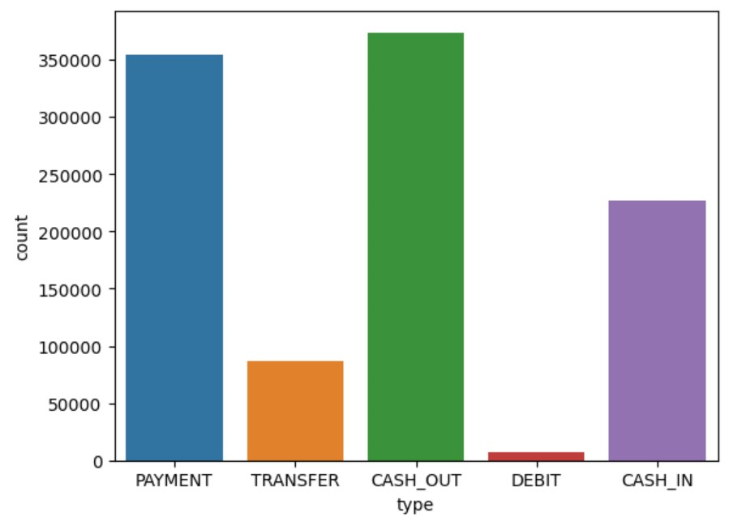
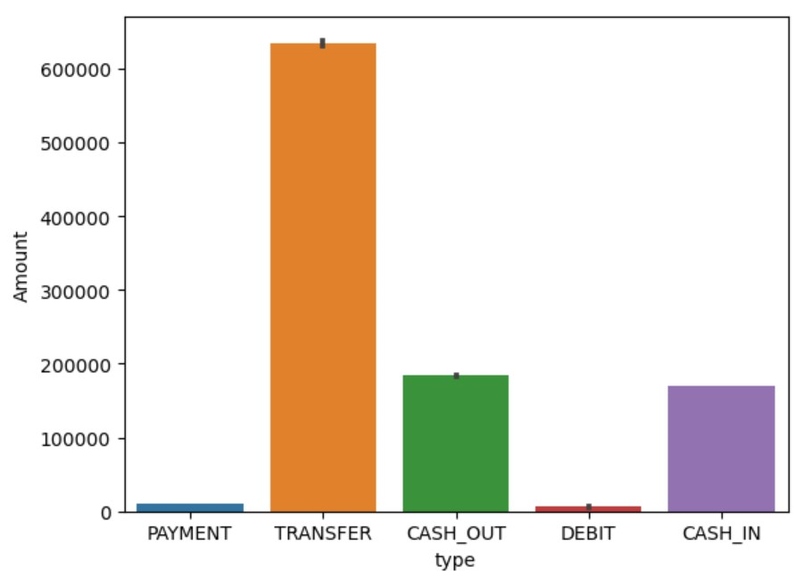
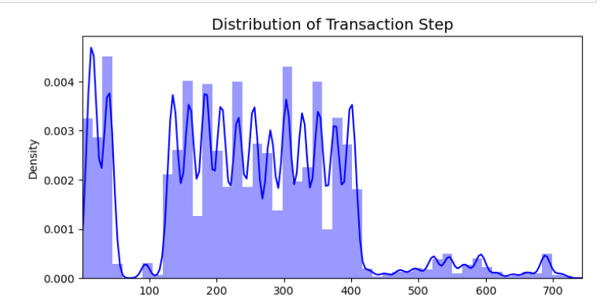
visualization
From the chart, it is seen that cash_ out and payment is the most common type of online transaction that customers use.
In this chart, 'transfer' type has the maximum amount of money being transferred from customers to the recipient. Although ‘Cash Out’ and ‘payment’ are the common type of transactions.
The above graph indicates the distribution of the step column.

Slide 7
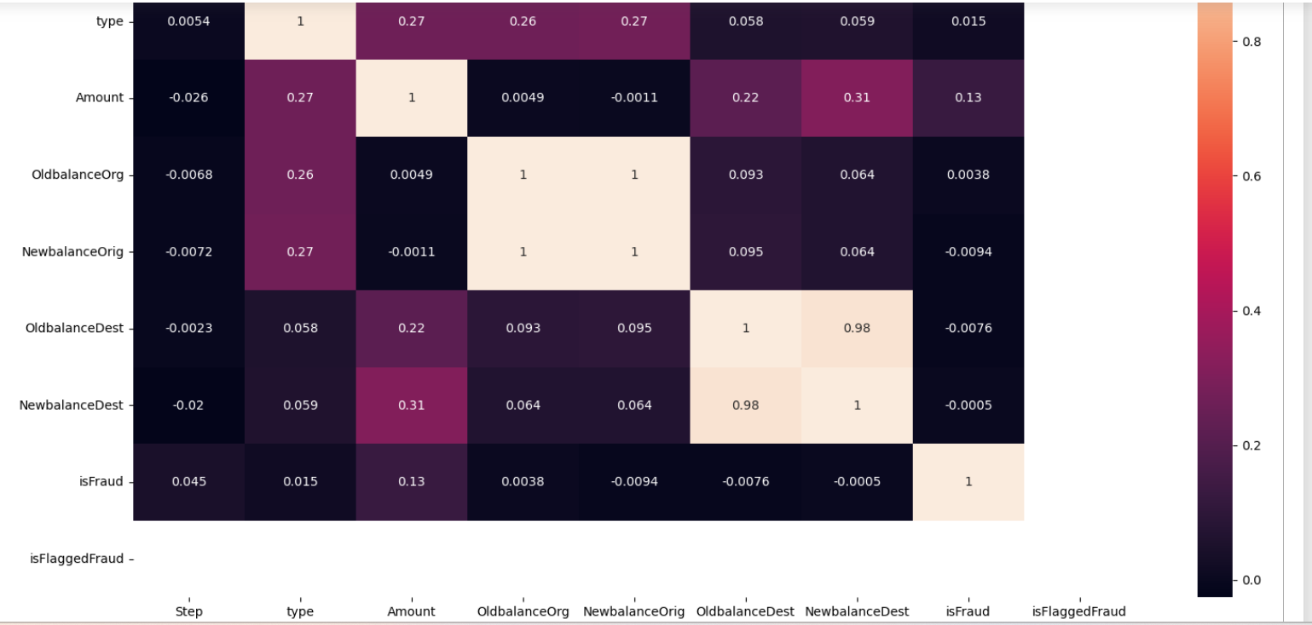
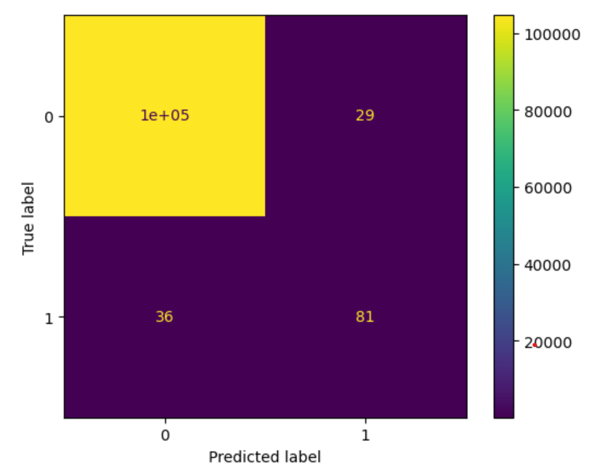
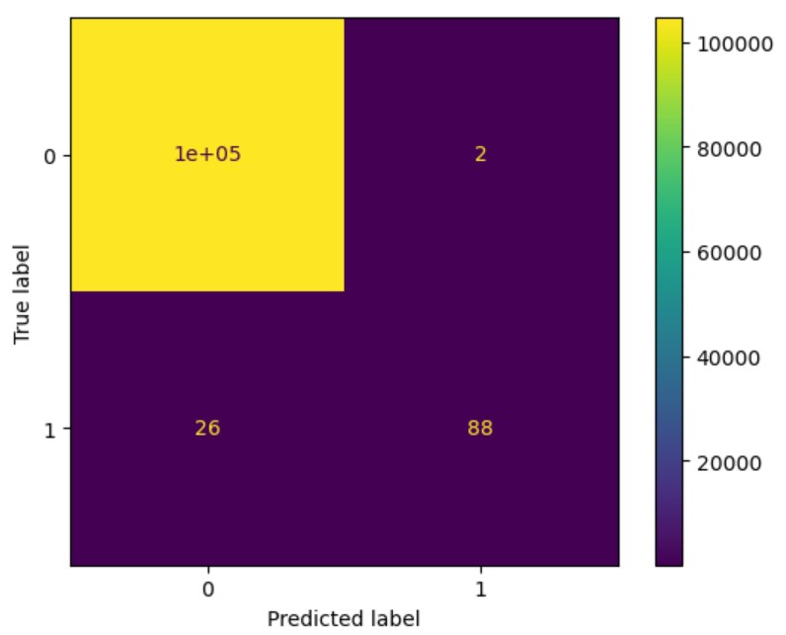
MODEL EVALUATION
The Decision Tree model with default parameters yields 99.96% accuracy on training data.
Precision Score: This means that 82% of all the things we predicted came true. that is 82% of clients transactions was detected to be a fraudulent transaction.
Recall Score: In all the actual positives, we only predicted 82% of it to be true.
Random Forest Tree model parameters yields 99.97% accuracy on training data.
Precision Score: This means that 99% of all the things we predicted came true. that is 99% of clients transactions was detected to be a fraudulent transaction.
Recall Score: In all the actual positives, we only predicted 81% of it to be true.
We explored correlation where it shows the relationships between variables(features) and how close they are related to each other. From the chart, we can see that balance before and after transaction are highly correlated compared to others.
Both the Decision Tree and Random Forest models outperform the Logistic Regression

Slide 8
conclusion
Upon training and evaluating our classification model, we found that the Random Forest model performed the best by a narrow margin. Therefore, Random Forest performs best with recall cross-validation accuracy of 87% which is important for our problem statement where false negative is our priority.
Random Forest Classifier model should be used because for this business problem, recall score is more relevant because it measures how many of the actual fraudulent payments the model identified as fraud.
Transaction History and Frequency - if unaccounted transactions occurs frequently should confirm genuinity of the transaction with the customer.
Instruct user to use own mobile or computers while doing transactions to avoid phishing attacks
Increased cybersecurity for banking websites and mobile applications

Slide 9
THANK YOU
Daksh
Daksh Makhija
35314813120
Manik Dhingra
75114813120

